Slide 1

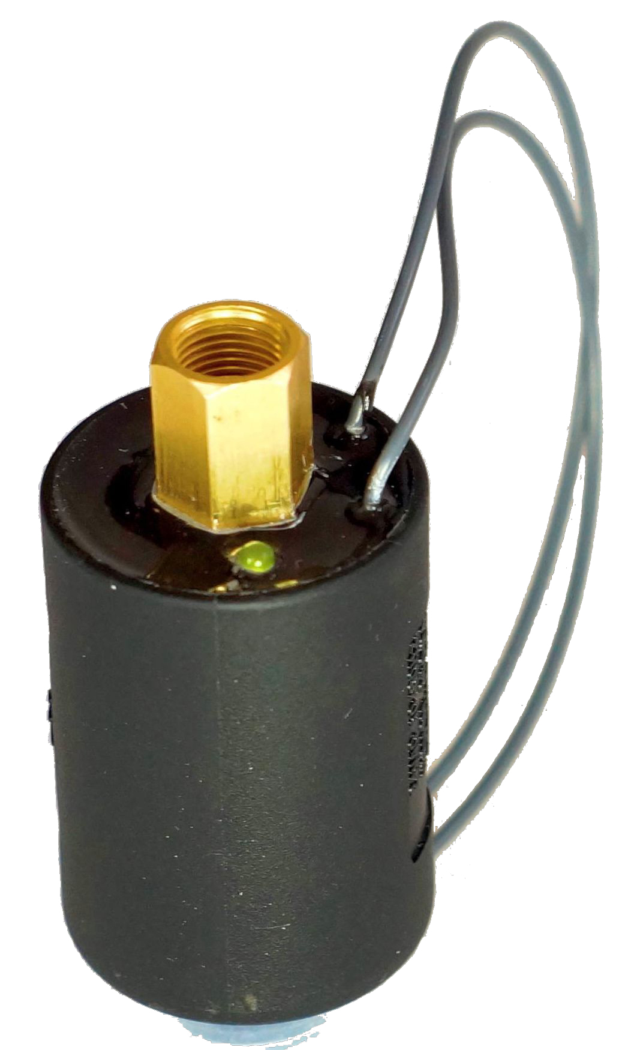
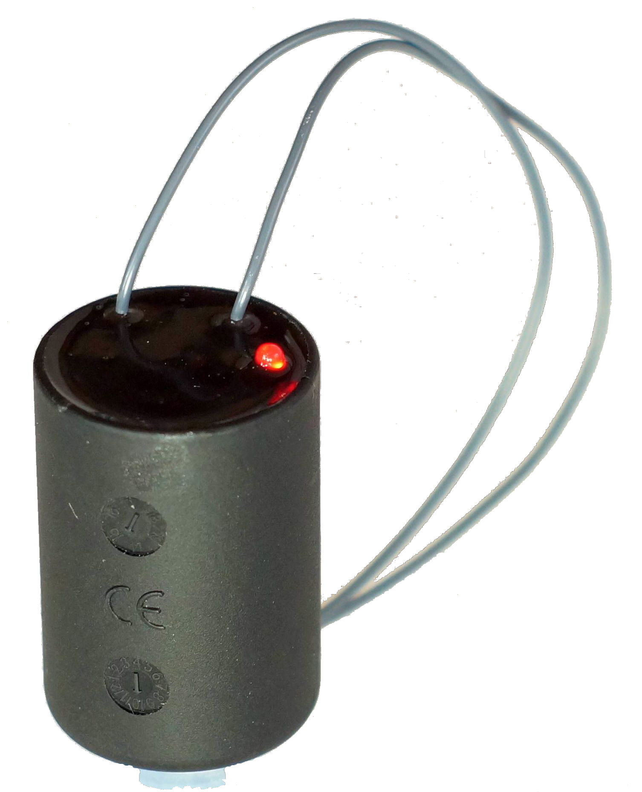
2Wire Decoder-in-Solenoid
Product Overview

Slide 2
Discussion Points
How Fusion changes 2Wire
Features / benefits
How does it work?
Installation
  Multi-wire
  2Wire

Slide 3
How FusionTM
Changes 2Wire
Allows one product to be used for either multi-wire or 2Wire irrigation control systems
Eliminates 50% of the wire connections common to 2Wire systems
Reduces field troubleshooting w/ LED visual indicators
Simple and easy to install

Slide 4
How Does it Work?
Traditional Multi-Wire Systems Layout

Slide 5
How Does it Work?
Traditional 2Wire Systems Layout

Slide 6
How Does it Work?
Decoder in Solenoid

Slide 7
How does it Work?
The Fusion is a solenoid w/ integral 2Wire decoder
Replace the OEM solenoids on the following remote control valve series:
  All 2-Way Rain Bird Valves (except 300BPE / 300BPES Series)
  All 2-Way Hunter Valves
  All 2-Way Toro / Irritrol valves
  Bermad 3-Way Valves

Slide 8
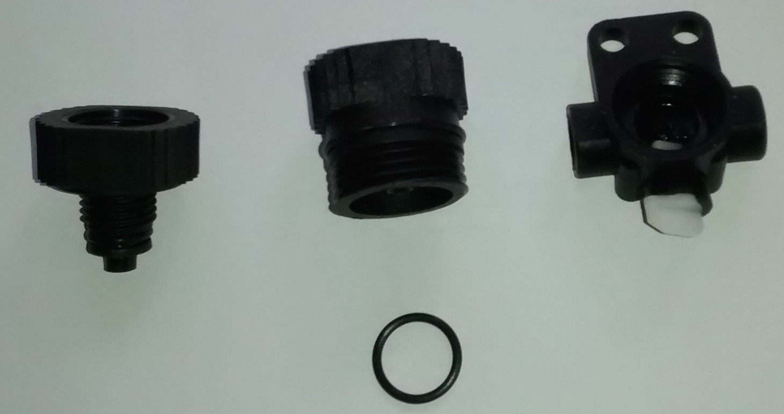
How does it Work?
All 2-Way Fusion solenoids come w/ corresponding valve adapters to mate with each manufacturer’s valves
In multi-wire irrigation control applications simply remove and replace the OEM solenoid with the corresponding Fusion solenoid/valve adapter
In 2Wire applications, program the decoder, then install same as above

Slide 9
Features / Benefits
Very low holding current allows more valves to be operated at one time, 2iwre or Multi-wire- assumes control system has this capability and there is sufficient capacity and delivery pressure in the mainline system, also doesn’t require controller transformers to increase in output
Eliminates 50% of the wiring connections common to 2Wire systems – lowers failure rate of poor wire connections
Reduces field troubleshooting time – Colored LED provides feedback
Similar to troubleshooting multi-wire systems, but easier

Slide 10
LED Color Coding
Multi-wire Applications
Green LED – 24 VAC power is being received from the controller and valve is being actuated
No color – there is either a broken common or pilot wire. If more than one station doesn’t operate it’s typically a broken common wire
2-Way Fusion Solenoid

Slide 11
LED Color Coding
2Wire Applications
Green LED – 24 VAC power is being sent down the 2Wire path
Red LED – The Fusion solenoid has not be programmed with a station address
Orange LED – The Fusion solenoid has received a message and the valve should be opening
No color – there is a break in the 2Wire path
2-Way Fusion Solenoid

Slide 12
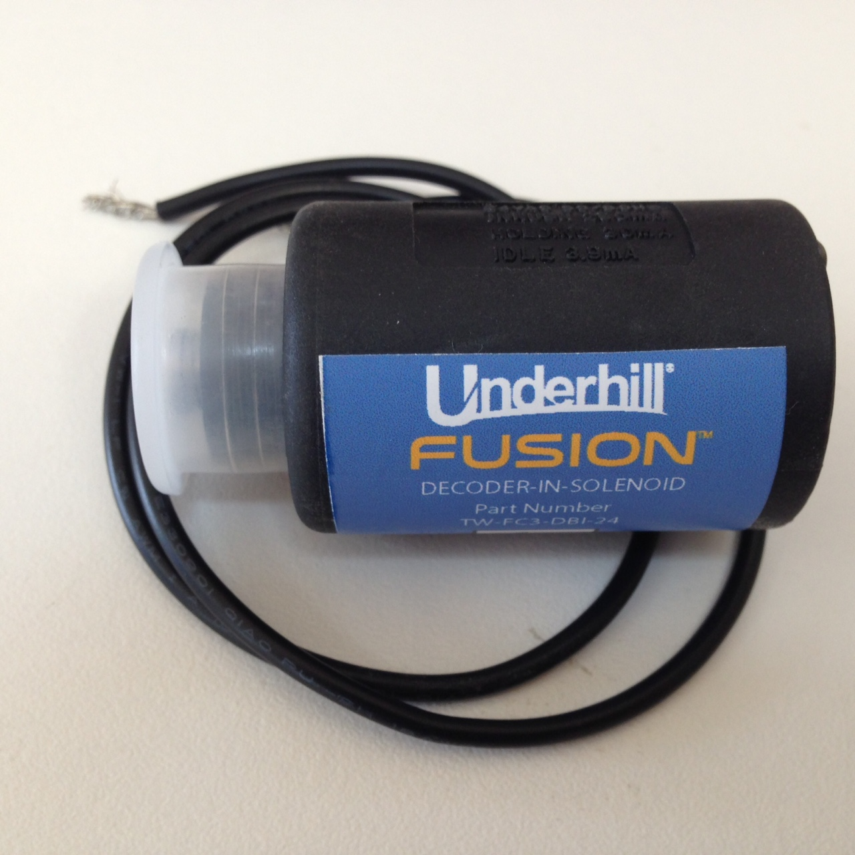
Installation
Multi-Wire Systems
Remove OEM solenoid and replace w/ Fusion solenoid and corresponding valve adapter
Adapts to solenoids w/ separate On/Off adapters (Toro / Irritrol
Make wire connections
Use DBYR connectors

Slide 13
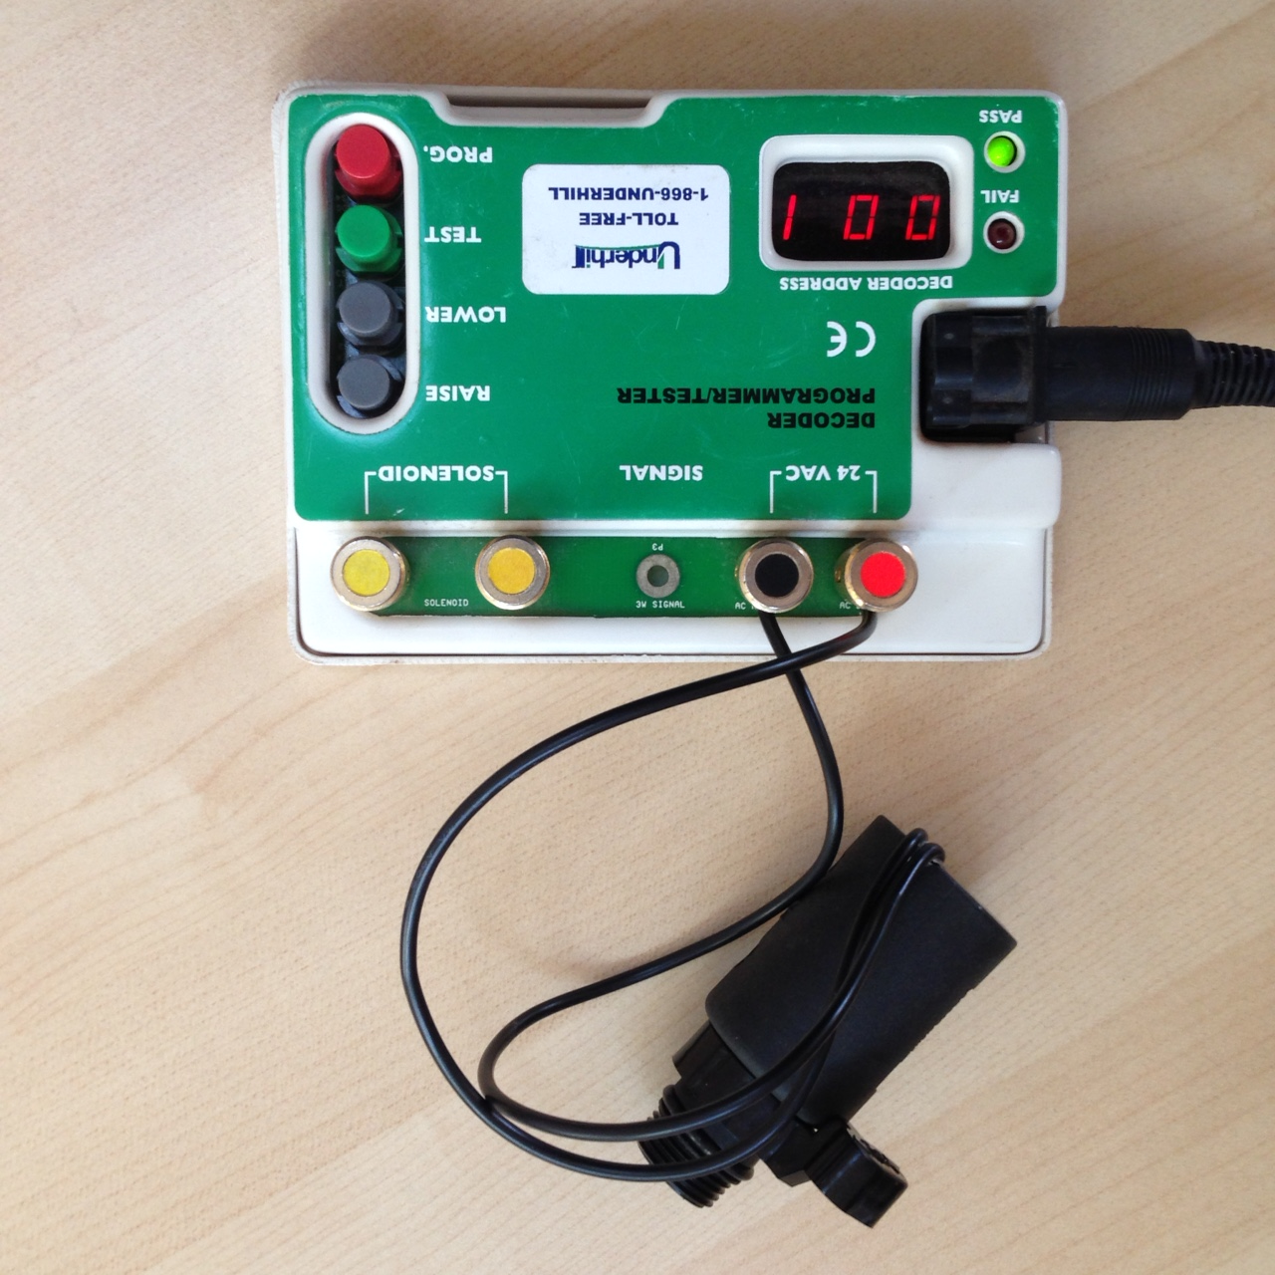
Installation
2-Wire Systems
Program the Fusion solenoid using an Underhill Portable Programmer, 1-63 stations
Remove OEM solenoid and replace w/ Fusion solenoid and corresponding valve adapter
Wire into 2Wire path
Make connections w/ DBYR connectors

Slide 14
Need Technical Support?
Greg Parker, Brand / Specification Manager
gparker@uicorp.net
or
(949) 427-6448
7:00am to 5:00pm PST M-Th
or
www.underhill.us

Slide 15
Thank You!

